Slide 1
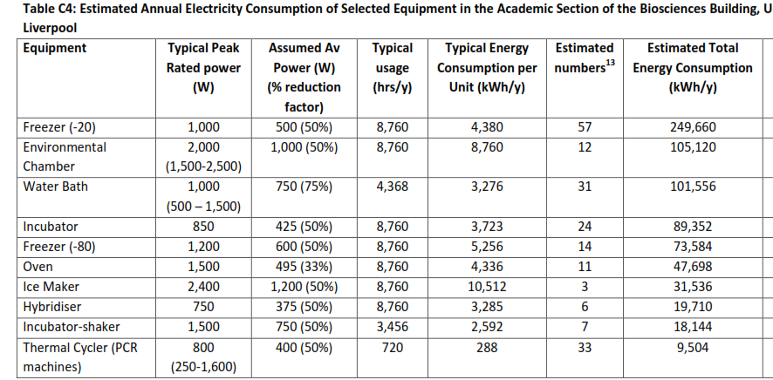

Slide 2
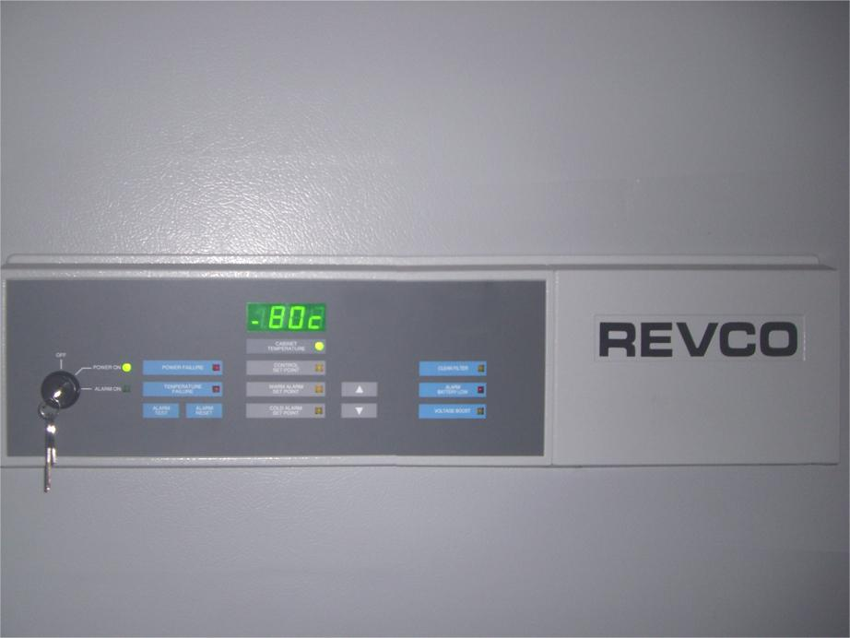
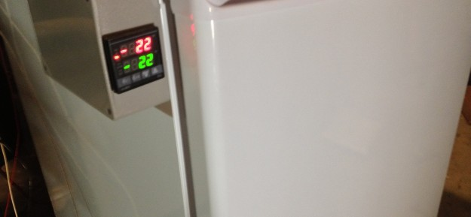
ultra-low freezers

Slide 3
ultra-low freezers: -80
energy consumption
15 – 20 kWh/day
-manufacturer data
-validated by monitoring

Slide 4
‘-70 is the new -80’

Slide 5
‘-70 is the new -80’
chill up freezers from -80 to -70
save 2-4kW per day

Slide 6
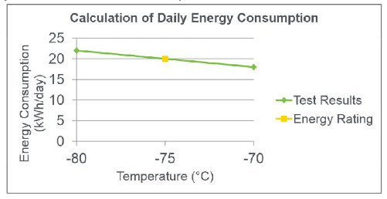
‘-70 is the new -80’
DOE

Slide 7
other best practices for ultra-low freezers
clean freezer coils, regularly defrost freezer
prolong lifetime of the freezer
save 12-25% energy

Slide 8
other best practices for ultra-low freezers
perform scheduled maintenance on freezers
prolong lifetime of the freezer

Slide 9
other best practices for ultra-low freezers
remove old, unneeded samples
fewer samples stored, fewer freezers are needed

Slide 10
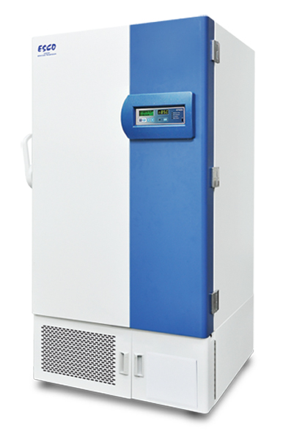
case study: ultra-low freezers
energy use
min 7,300 kWh/year PER FREEZER
example measure
Stirling freezers
switching to Stirling freezers can save
55% min energy reduction
additional benefits
reduced HVAC related usage
reduced risk to samples

Slide 11
other best practices for ultra-low freezers
transfer samples to other storage paradigms
-20 freezers
ambient temperature storage containers
fewer samples stored, fewer freezers are needed

Slide 12
are there best practices that will both
reduce energy consumption
and
prolong the life of the freezer?

Slide 13
best practices for ULT freezers
clean freezer coils, regularly defrost freezer, change filter
save 12-25% energy

Slide 14
best practices for ULT freezers
perform scheduled maintenance on freezers
save min 10% energy

Slide 15
best practices for ULT freezers
remove old samples
fewer samples stored, fewer freezers are needed

Slide 16
‘-70 is the new -80’

Slide 17
why are freezers set to -80?

Slide 18
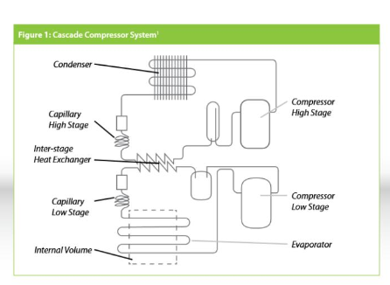
ultra-low temperature freezers: how they work

Slide 19
‘-70 is the new -80’
chill up freezers from -80 to -70
save 2-4kW per day

Slide 20
‘-70 is the new -80’
DOE

Slide 21
what is the evidence that -70 is ok for samples?

Slide 22
‘-70 is the new -80’
CU-Boulder
Dartmouth
Harvard
UC Davis
UC Santa Barbara
UPENN

Slide 23
replace old freezers

Slide 24
replace old freezers
with more energy efficient models
ambient temperature storage containers for nucleic acids

Slide 25
how is this saving money?

Slide 26
less energy = less stress on the compressors
= more up-time, longer freezer life

Slide 27
possibility of financial assistance from UCSD

